Slide 1
Shri Chhatrapati Shivaji College, Omerga
Dept. of Physics and Electronics
Subject: Physics Paper No. XX
Class: B. Sc. VI Semester
Optical Fiber
Dr. A. S. Padampalle

Slide 2
Introduction:
A thin flexible and transparent wire prepared for light propagation is called optical fiber. The optical fiber has been constructed for the following reasons:
The light wave cannot traverse long distance in air without any losses.
To make loss less light wave communication, the optical waves can be guided through optical fibre.
The optical fiber can be used for the many of industrial application and medical applications as well. The optical fiber consists of two media kept one inside the other. The centre transparent medium of optical fiber is called “core” and the outer is cladding. The refractive index of core will be always higher than the refractive index of cladding.

Slide 3
1. The propagation of light in optical fiber.
The light propagates through optical fiber through “Total internal reflection”.
The total internal reflection appears due following reasons;
When light traverse from optically rarer medium (like air) to denser medium (glass) the refracted ray moves towards the normal drawn on the interface of media as in Snell’s law. Conversely, if light traverse from denser to optically rarer medium, the refracted ray moves away from the normal drawn on the interface of the medium fig.(1a)
If the angle of incidence increases (fig.1b), to certain value for which the refracted ray happen to be on the interface of medium. The angle of incidence s known as critical angle (θc)(fig.1c).
If the incident angle (fig.1d) increases more than critical angle, then the refracted ray falls on the same denser medium with no refraction. “This reflection of light is called total internal reflection”.

Slide 4
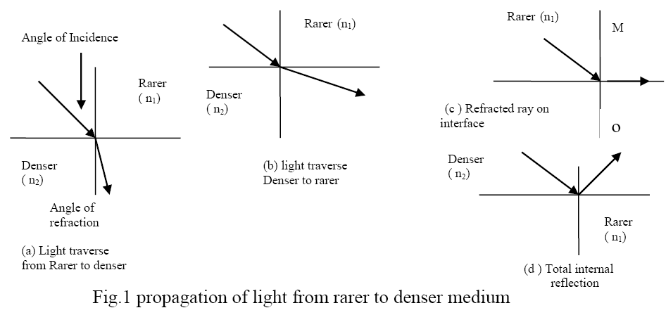
Thus, following are the conditions for total internal reflection:
1. The ray of light should be traverse from denser to rare medium.
2. The incident angle should be more than the Critical angle (θ_{i} >θ_{c}).

Slide 5
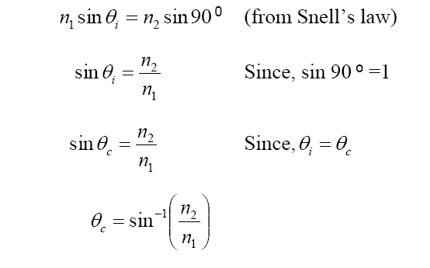
If the incident ray exceeds the critical angle, the refraction would be turned in to reflection called total internal reflection. The critical angle is used for the mathematical expression to the occurrence of total internal reflection (fig.1c)
Therefore, to propagate the light through optical fiber, the incident angle should be made higher than the critical angle at various points on the core, so that the light can be traversed by the total internal reflection at those points.
To achieve the above, the size of core should be adjusted suitably which causes different types of optical fiber based on size, (no. of modes) refractive index and modes of propagation.

Slide 6
1.2 Classification
In the optical fibers the materials used, refractive index and mode of propagation of light are used for classification as follows:
1.2.1 Material Based optical fibers,
The material based classification results to the following types:
Plastic made fibers.
Glass made fibers.
The plastic made fibers are obtained from polymers of transparent to light, flexibility and interaction less to light etc,.
For example poly methyl metha acrylate (PMMA), polyethylene (PE), polystyrene (PS) are used as core materials.
Glass made fiber is also fabricated from flexible glass as core with suitable drawing technique in presence of impurities. Therefore, the above types of optical fibers are limited to some application.

Slide 7
1.2.2 Classification of optical fibers based on refractive index
The types of optical fiber can be classified based on the refractive index are
1. Step index fibers.
2. Graded index fibers.
Step index :
If the refractive index of core remains the same from the centre of the core to the core-cladding interface; those optical fibers are known as step index fibers (fig.2a). The distance from centre of core to interface of fiber vs. refractive index is shown as below:

Slide 8
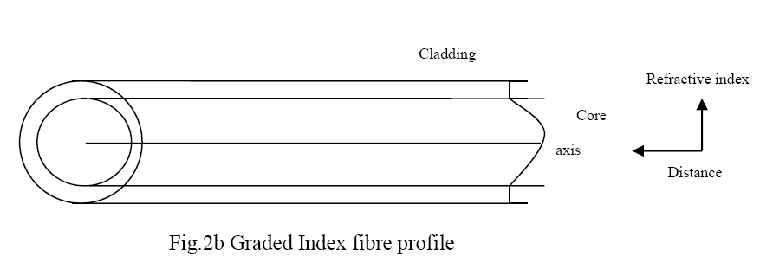
Graded index
These types are made of varying refractive index of core material. Therefore, the refractive index changes with distance form the centre of fiber to core-cladding interface. The profile of above is as shown in the fig 2 b.

Slide 9
1.2.3 Modes of propagation based optical fiber
Based on modes of propagation of light through core, the following are the types of optical fiber identified.
Single mode fibers
Multimode fibers
Single mode fibers
Considering the light as electromagnetic radiation, the possible modes of propagation are transverse electric (TE) modes and transverse magnetic (TM) modes.
Among them, the TE₁₀, TE₁₁, TE₀₁ and TM₁₀, TM₁₁, TM₀₁ are possible, within which the modes TE₁₀ and TM₁₁ are significant.
If the core size is adjusted to allow only one mode of light wave propagation is single mode fiber, whose profile (fig.2c) is shown below:

Slide 10
Multi mode optical fiber
If the core size has been adjusted to allow more than one mode of propagation of light wave is multimode fiber. The profile of multimode fibers is as shown below:

Slide 11
1.3 Parameters of optical fibers
The parameters of optical fibers are:
Radius of the core
Numerical Aperture
Acceptance angle
1.3.1 Radius of the core
The size of optical fibers plays crucial role in the light wave propagation through fibre.
Therefore, radius of the core is significant to decide mode of propagation in fiber.
The thickness/diameter of the core can be measured in spite of measurement of radius. For the purpose the profile projector can be used.

Slide 12
1.3.2 Numerical aperture (NA)
Numerical aperture (NA) is a light gathering property of optical fibre, which gives the quantity of light that brought into the centre of optical fibre in terms of incidence angle.
To calculate NA, consider a longitudinal section of fibre as in fig.(3).
Let n₀, n₁, n₂ are the refractive indices of air (outside optical fibre), core and cladding respectively.
Let θ_{i} , θ_{r} are incidence angle and refracted angle of the light through fibre.

Slide 13
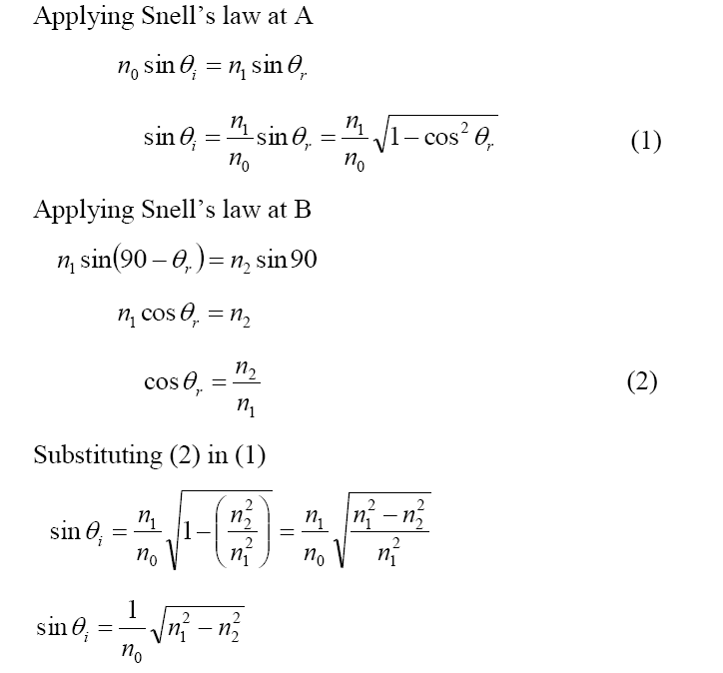

Slide 14
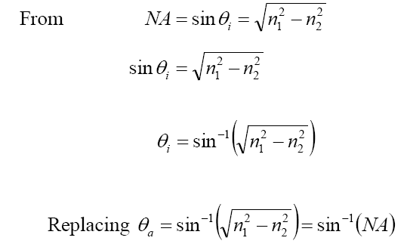
1.3.3 Acceptance angle
It is a semi vectorial angle that formed by the set of incident rays at the centre of fibre, which helps to decide the size of core.

Slide 15
1.4 Applications of optical fibers in industry and medicine :
1.4.1 Optical fiber in communication:
The conventional method of communication has more limitation toward signal security and also affected by change in atmospheric factors. To overcome these limitations and factors, the optical fibers are introduced in communication system. In optical fiber communication the protocol consist of transmitter unit and receiving unit in the system.
The transmitter unit
The transmitter unit contains light source, signal to be transmitted, light modulator, amplifiers and coupler. Similarly, the receiver unit consists of couplers, light detectors, amplifiers, filters and output device. The transmitter unit and receiver unit are connected by suitable optical fiber.
The layout of optical fiber communication is shown in the fig.4
The signal
The signal to be transmitter can be voice, music as audio or movie as video signals. Generally, the signals will be in analog form which can be converted to digital using A/D converters in the transmitter.

Slide 16
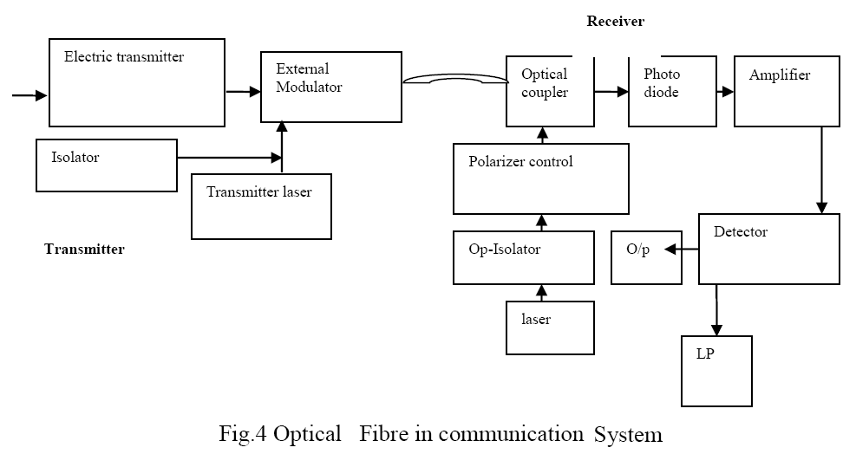
The optical communication system consist of transmitter unit containing digital source, electrical transmitter, laser as light source, modulator and transmitter channel.
In receiving end, the light detector, amplifier, optical coupler and the de modulator are available.

Slide 17
In transmitter, the digital signal will be converted in to electrical signal, which modulates optical carrier wave through transmitter wave by laser in terms of intensity, frequency or phase.
Modulator
In the modulator the mixing of signal with optical carrier wave takes place. The modulation can be
Simple ON-OFF keying (OOK)
Amplitude shift keying (ASK)
Frequency shift keying (FSK)
Phase shift keying (PSK)
Multi level modulation keying (MMK)
The function of the modulator may be electro optic or acoustic optic phenomenon.

Slide 18
Receiver unit
The output of transmitter can be connected to the optical fiber which ends at receiver.
The receiver unit can be two type, they are:
Homodyne receiver
Heterodyne receiver
In homodyne receiver, one way communication is encouraged where as the heterodyne receiver encourages to transmit and receive the signal in a single receiver unit. If the transmitted signal alone be received through the receiver whose frequency synchronize with the local laser frequency, it will be homodyne receiver (f_{s} = f_{l}).
Heterodyne receiver
If the transmitted signal be received through the receiver whose frequency does not synchronize with the local laser frequency, it will be heterodyne receiver (fs ǂ fl). The homodyne and heterodyne receivers are shown in present fig
Transmitter laser
To achieve high bit rate and long range data transmission with low error rate a single mode transmitter laser can be used.

Slide 19
Isolators
There can be undesired reflection between transmitter lasers to the external modulator. To avoid the consequence as reflection this improves laser emission spectrum. Further, it causes quality deterioration which causes quality of transmission. To avoid above, a optical isolation is used across external modulator and transmitter laser.
External modulators
The direct modulation technique contain semiconductor component such devices directly modulates using injection current by charge carriers in terms of intensity amplitude and frequency adding additional noise.
The above can be avoided in external modulators.
Optical coupler
The optical coupler mixes the receiving signal and local light wave from laser to improve system performance, quality of emission spectrum of laser. This optical coupler has 2 inputs through super imposed optical waves and one output to photodiode

Slide 20
Photodiode
The photo diode gives electric current corresponding to optical input power. Normally, PIN diodes or avalanche diode (APD) are used. Among them, the PIN diodes are significant due to input optical power proportional to square of input electric field.
It generates electric current proportional to optical input power. For the purpose PIN and APD are used. The gain of APD is improved by performance of coherent optical radiation PIN diodes are used in practice. As the optical power is proportional to the square of the electric field, the superposing of two fields is linear. In photodiodes current also contain an immediate frequency which referred as IF signals.
Inter mediate Frequency (IF) filters
The IF signal, the difference of local laser frequency and frequency of received light are significant in the present communication system.
To get homodyne detection, care should be taken to get phase and frequency to match.
To get heterodyne detection, the signal should be selected by IF filter and the demodulated with respect to amplitude/frequency or phase.

Slide 21
All type of demodulator can be used. The output of demodulator may also contain noise which can be eliminated by low pass filter.
Output device
The filtered nose will be sampled and hold receives the signal after filter to be connected to output device.
1.5 Some losses in optical fibers
The optical fiber does not experience the loss in terms of intensity of light. However, the presence of impurities, scattering at the edges, geometry of structure and dispersion of light causes some losses.
Transmission loss/attenuation (α)
If the intensity of light at the second end of the optical fiber be I_{out} and intensity at first end be I_{in}

Slide 22
Other possible losses in optical fiber
The possible losses are absorption, scattering, radiation losses and geometric losses.
The absorption loss
The absorption losses appears as
Extrinsic losses
Intrinsic losses
Atomic defect losses
Extrinsic losses
The extrinsic loss appears due to presence of impurities which absorbed the light. The impurities may be due to presence of Fe, Cr, Co and Cu in the core material.
The impurities could absorb the energy that may reemit the absorbed energy during the de excitation in different wavelength which causes loss of intensity to original light of specific wavelength.
Intrinsic loss
Since, the fiber core itself absorbs some quantity of energy which is known as intrinsic loss.

Slide 23
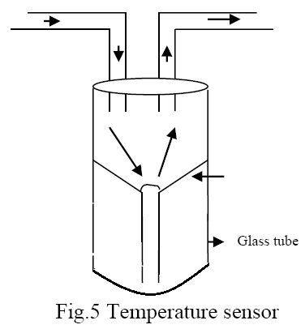
1.6 Optical fibers as sensors
Generally, optic sensor consists of light source, optical fibers and detector.
The sensors are Two types viz., active sensors and passive sensors.
The physical changes directly changes the electrical responses called active sensors; where as the physical changes are indirectly recorded to sensing is called passive sensors.
Temperature sensor
The light can be arranged to fall on reflecting surface and the associated phase angle is be measured. The reflecting surface can be varied using temperature variation, which causes additional phase angle to light wave as seen in the fig.5. When light thrown on the reflector by optical fibre, the initial and final response can be compared for measure of temperature by relative correlation.

Slide 24
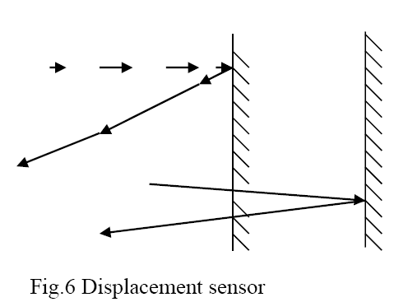
Displacement sensors
The light is sent through transmitting fiber and further it is allowed to fall on moving target. The light ray falls on the surface and gets reflected.
The incident ray could mix with reflected wave and forms standing wave to which the phase angle shift can be measured.
The fig 6 indicates displacement sensors.

Slide 25
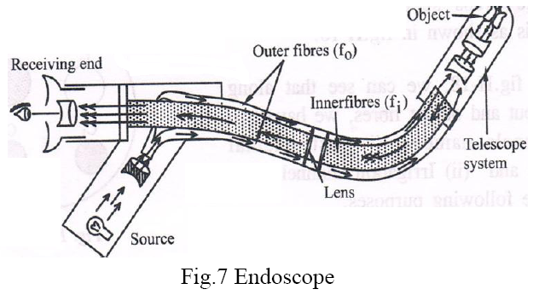
Optical fibers in medicine
Endoscope
The endoscope is a instrument through which small surgery could be performed. The construction details are given as in fig.7. The ray of light is obtained using laser the light is partially allowed to pass through optical fiber kept inside the tube as shown in the figure. The output of fiber is connected to lens system and then to prism to split the object. The reflected light can be obtained using polished prism and returning ray will be visualize to get the real position of inner organs.

Slide 26
Thank you !

